Slide 1
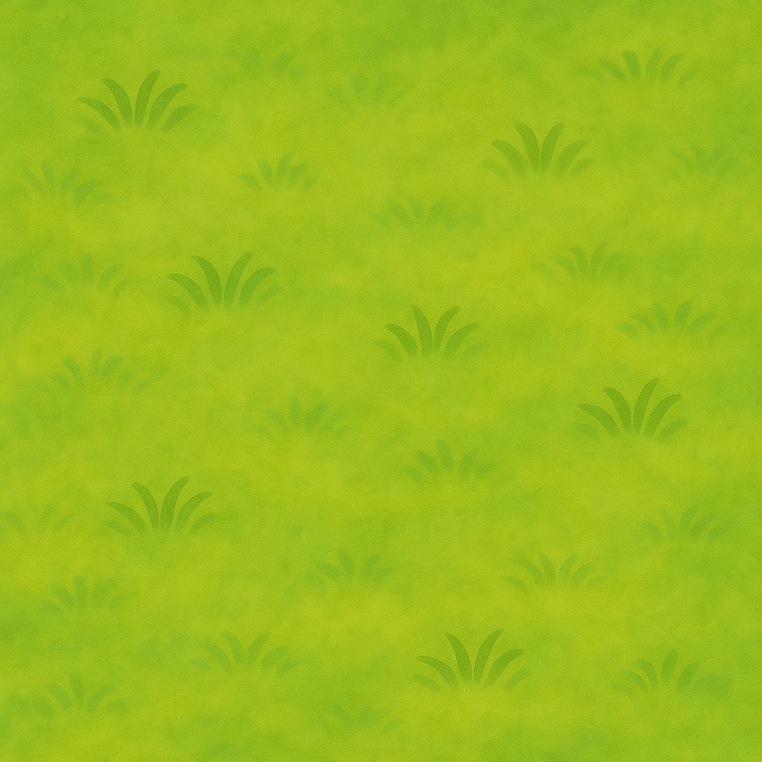







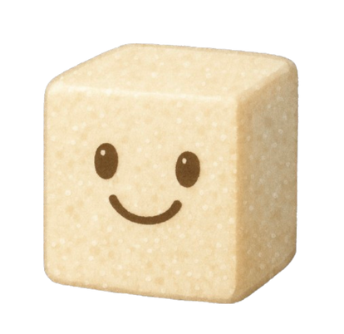

TEAM NAME

Slide 2
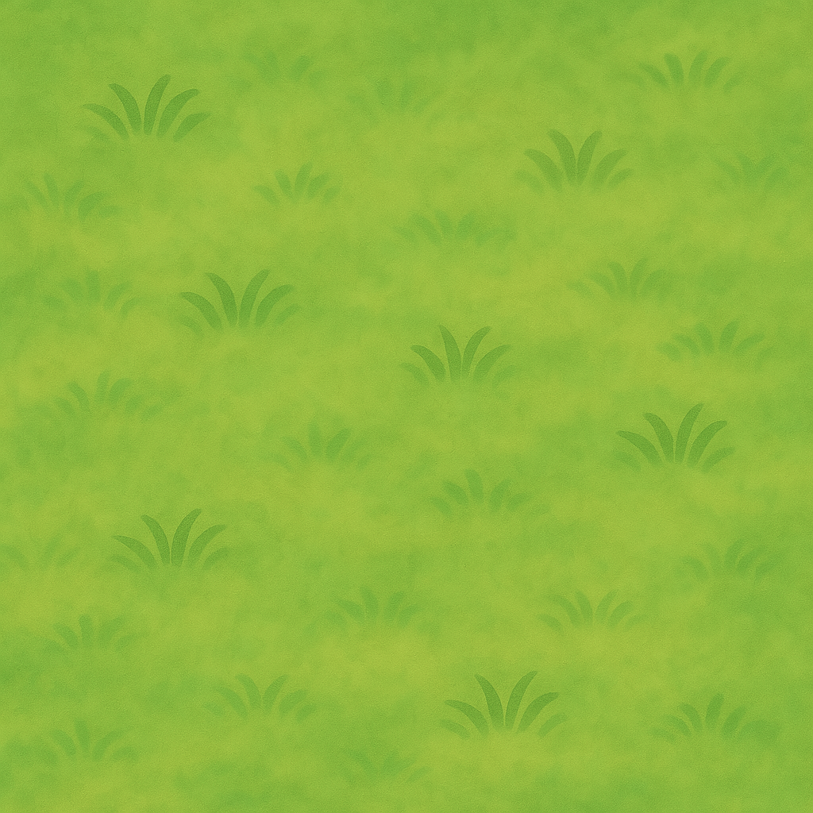
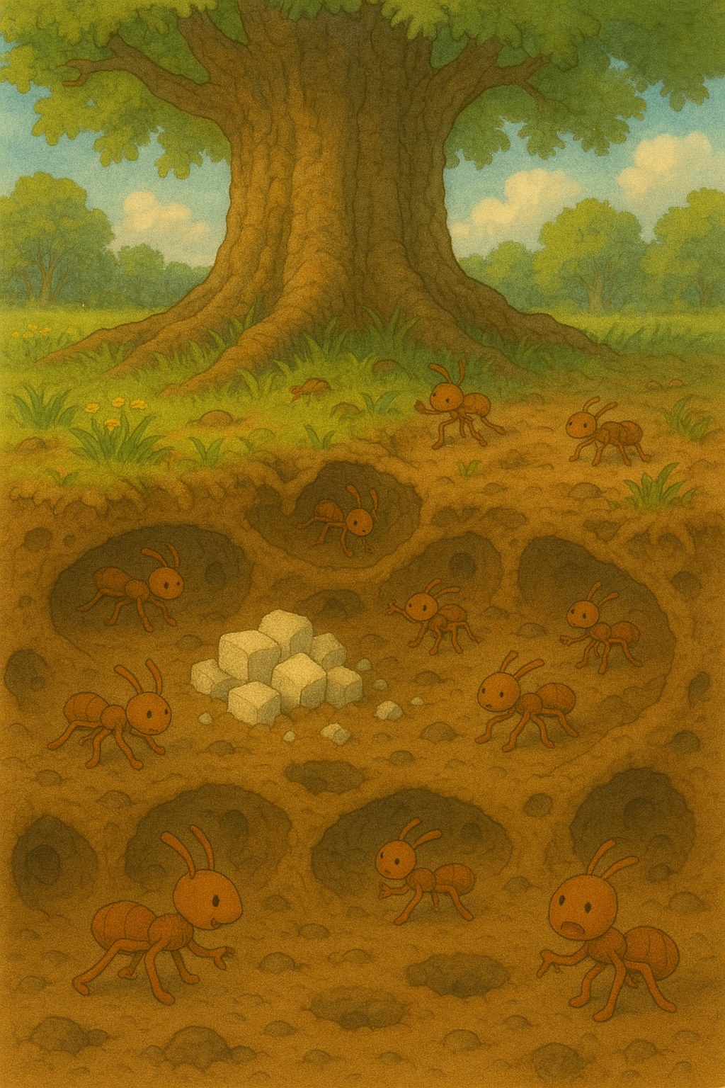
Once upon a time...
Beneath the oak, the ants would strive,
To build and hoard, to work and thrive.
They stacked their sugar, safe below,
While sun and summer warmed the glow.

Slide 3
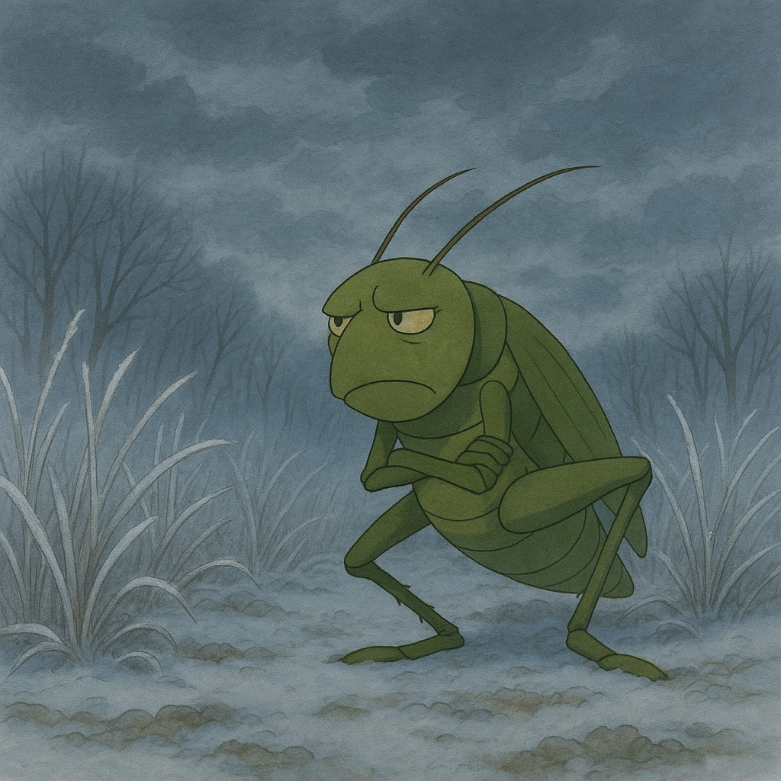
Above, a grasshopper danced with pride,
"Why work?" he laughed, "Just sing and glide!"
But winter came with biting cold,
And songs were silenced, young and old.

Slide 4
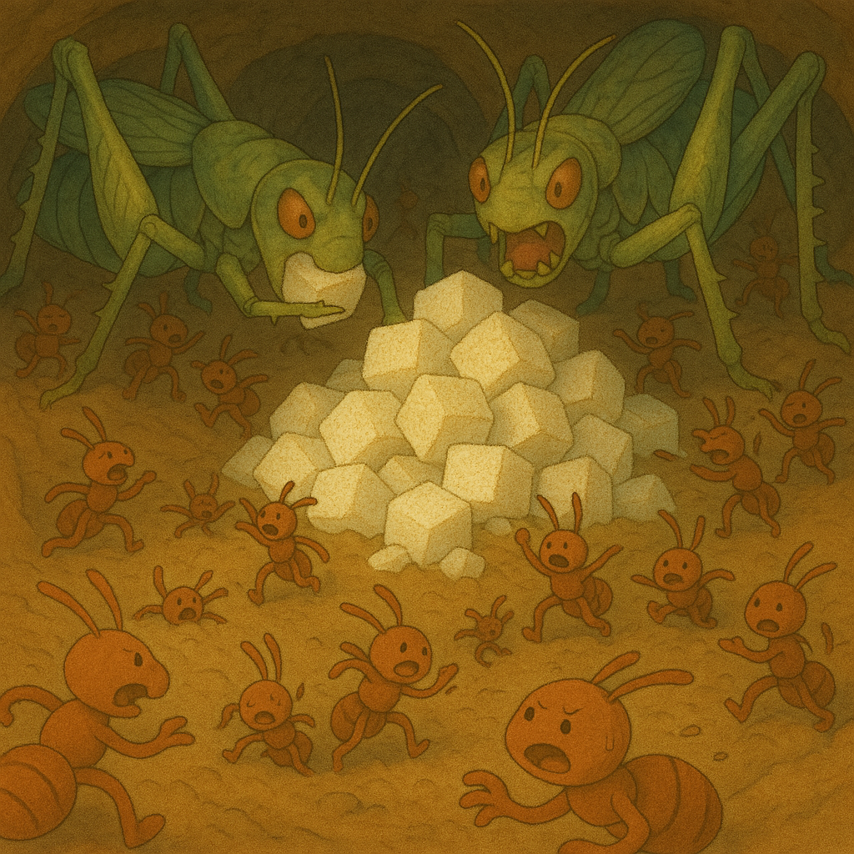
He wandered hungry, weak and slow,
To find the hill — now laid low,
The sugar gone. The chambers wrecked,
Ant cries still echoed through the depths,
Until silence wrapped the forest tracks.

Slide 5
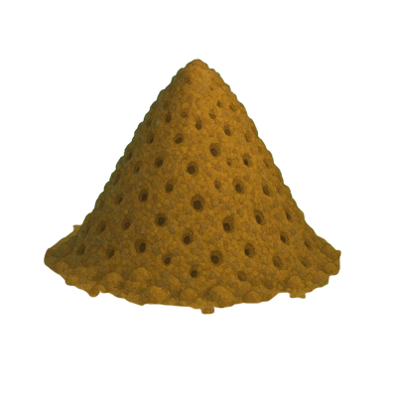
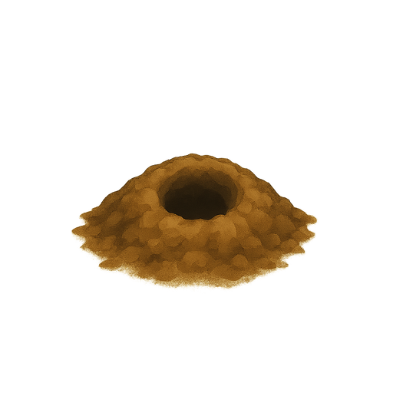
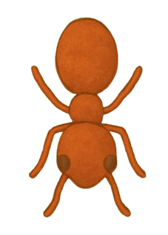
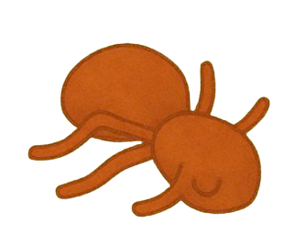
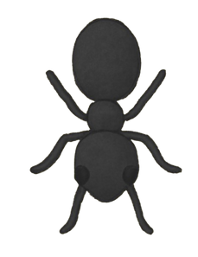
Gameplay overview
Ant colony management + sandbox-style survival
Balance sugar usage for survival and sweetness
Strategically place ant structures
Survive hunger, mood swings, and natural threats

Slide 6
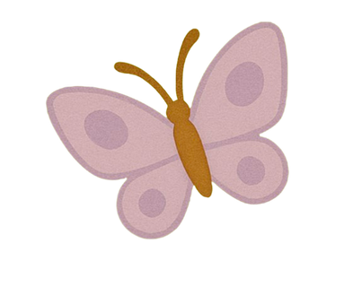
Key features
01
02
03
Drag-and-Drop World Building
Sugar = life
Ant Life Simulation

Slide 7
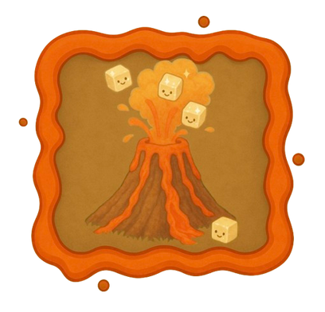
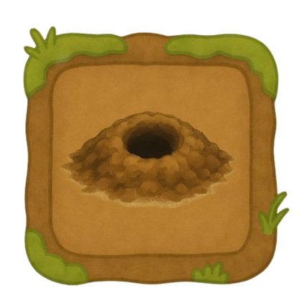
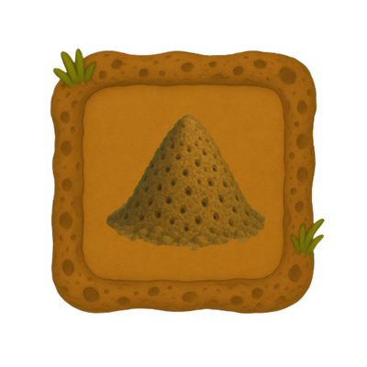
Drag-and-Drop World Building
1) Sugar Volcano – erupts sugar cubes: vital resource
2) Ant Hole – lays eggs & grows population
3) Ant Hill – keeps ants organized & prevents wandering

Slide 8

Sugar = life
Increases sweetness (affects reproduction)
Reduces hunger bar (keeps ants alive)

Slide 9
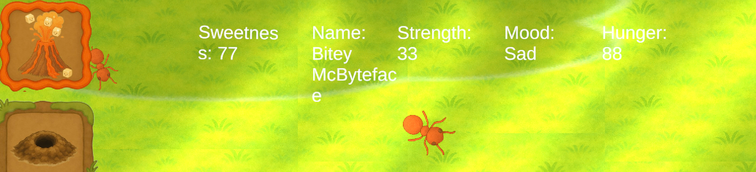
Ant Life Simulation
Hover to see: name, hunger, mood, sweetness and strength
Ants respond to hunger:
Low hunger = desperation (fast movement)
High hunger = death at 100

Slide 10
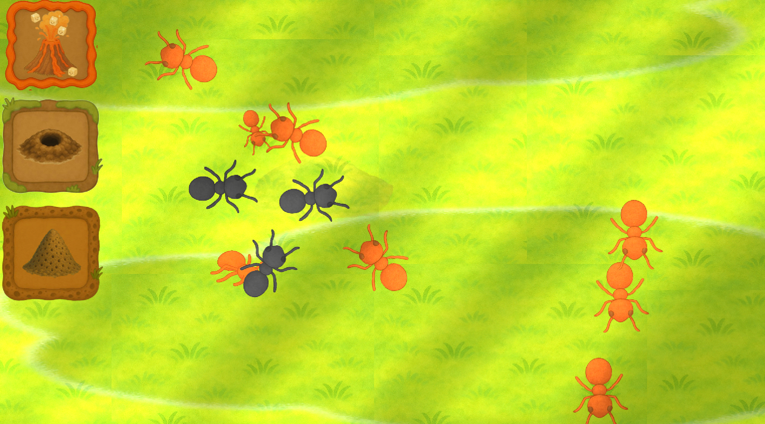

Slide 11
Neural network between ants: works on the basis of different attributes specific to each ant and how they react to it
Exciting additions of enemies: return of the grasshoppers
Classes: War ants, Farming ants, etc
Change of Seasons
MORE STRUCTURES....
Future Scope?

Slide 12
TIME LINE
Vertical Slice
2 months
Polishing
1 month

Slide 13
Thank you

